Slide 1

A Case Study Analysis on Cybercrime

Slide 2
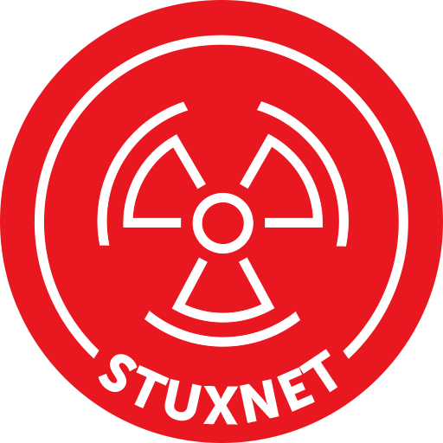
Chosen Country Detail
Chosen Country: Iran
Reason:
This country was chosen because it was the first to confront the first dangerous virus, which causes the physical damage of vulnerable gadget or devices.
Iranian nuclear program was attacked by a formidable force.

Slide 3
Stuxnet
Reasons:
The most sophisticated malicious software that has ever been observed in public.
Uses up to 6 different exploitable vulnerabilities.
Has 3 Root kits.
Infect SCADA Systems.
The first piece of malicious software that could deliver a physical payload.
Notes:
Stuxnet, which was created in June 2009 and started spreading in late 2009/early 2010, was the most powerful and complex virus yet encountered. Microsoft published a fix for this issue in August 2010 that was discovered in July.The U.S. and Israel co-created nuclear program in Iran was one target.Stuxnet exploits 6 flaws (5 is in Win and the 1 is in Siemens). The 1.5 MB file is an object-oriented compilation of C and C++, among other languages.User mode, kernel mode, and a PLC rootkit are all included.The virus propagated through shared network drives and USB flash drives. It auto-updates through HTTP connections to two websites on the internet (encrypted connection)When it was released, it was the first piece of malware to actually include a physical weapon.

Slide 4
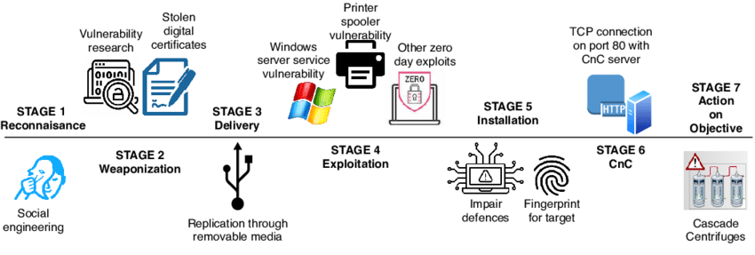
Stuxnet Description
Description:
The Stuxnet worm was explicitly built and distributed by a government with the intention of attacking the Bushehr nuclear power plant in Iran [1]. The United States and Israel are the most common suspects in this case.
Malware that was able to infiltrate systems running WinCC and PCS 7 SCADA and spread itself across networks.
Seized the opportunity presented by the fact that PLCs are typically uninsured.
After getting inside, able to reprograms the PLCs that control the machines.[2].
Notes:
It is believed that the destructive computer worm known as Stuxnet has been in development from at least 2005, however it was not discovered until 2010. Stuxnet is a computer worm that attacks supervisory control and data acquisition (SCADA) systems; it is widely thought to have harmed Iran's nuclear program. It is commonly believed that the United States and Israel worked together on the worm as part of a combined operation codenamed "Operation Olympic Games," despite the fact that neither nation has publicly claimed credit for it. Stuxnet is designed to infiltrate programmable logic controllers (PLCs), which are used to automate electromechanical activities like the control of equipment and industrial processes like the centrifuges used to separate nuclear material from gas. Utilizing four previously unknown vulnerabilities.Stuxnet infects computers using the Windows OS and connecting to Microsoft-controlled networks in order to locate and destroy copies of the Siemens Step7 control program. Stuxnet allegedly infiltrated Iranian PLCs, gathered data from factories, and triggered catastrophic failure in their rapidly spinning centrifuges.Stuxnet is not domain-specific in its design or architecture, therefore it may be modified to target current SCADA or PLC systems.Infectious malware that spreads across networks and infects WinCC and PCS 7 SCADA systems capitalized on the fact that PLCs are often not protected by firewalls or other security measures. Possessed the capacity to re-program the PLCs within the equipment once insideallowed for the potential of influencing the operation of remotely operated machines [2].

Slide 5
Iran Analysis Against Stuxnet
Nobody has ever seen something even a little bit like that. No one could figure out who might have made such a advanced, complicated and unique piece of malware [3].
In June of 2010, a Belarus-based security firm called as VirusBlokAda [4] discovered that Stuxnet was operating on Iranian systems.
Iran responded to the epidemic by assembling a special squad to combat it.
Since so many computers in Iran are infected with Stuxnet, Iran will need to exercise heightened vigilance to prevent reinfection.
Notes:
At the time, the security world gasped at the sophistication of Stuxnet. No one had ever seen anything like it. Obviously, everyone was wondering who could have been behind such advanced and unprecedented malware, which is perhaps the only one—at least that we know of—to really warrant the definition of "cyberweapon.“
The attack was so well-done that the virus worked undetected for months, and its victims didn't know about it until security companies around the world discovered it and started talking about it.
Stuxnet was discovered on systems in Iran in June 2010 by a security firm from Belarus – VirusBlokAda. It is however believed that it had been released more than a year before that. Stuxnet uses multiple methods and zero-day exploits to spread itself via LANs or USB sticks.
No country has ever claimed or admitted responsibility. But six years later, it's widely assumed that the United States and Israel were the culprits.
In response to the infection, Iran assembled a team to combat it. With more than 30,000 IP addresses affected in Iran, an official said that the infection was fast spreading in Iran and the problem had been compounded by the ability of Stuxnet to mutate. Iran had set up its own systems to clean up infections and had advised against using the Siemens SCADA antivirus since it is suspected that the antivirus contains embedded code which updates Stuxnet instead of removing it.

Slide 6
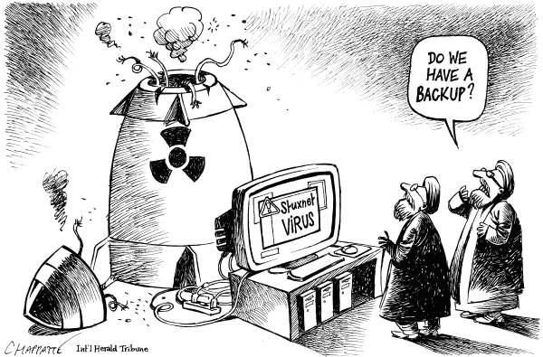
Stuxnet Cost
Cost of making Stuxnet:
It is believed that developing the Stuxnet virus cost one million dollars (about Dh3. 6 million) [5].
Damage due to Stuxnet:
Stuxnet is estimated to have destroyed around one-fifth of Iran's nuclear centrifuges.
More than 20,000 computers at 14 Iranian nuclear sites were infected, resulting in the destruction of around 900 centrifuges [1].
Notes:
Stuxnet is a malicious computer worm first uncovered in 2010 and thought to have been in development since at least 2005. Stuxnet targets supervisory control and data acquisition (SCADA) systems and is believed to be responsible for causing substantial damage to the nuclear program of Iran. Although neither country has openly admitted responsibility, the worm is widely understood to be a cyberweapon built jointly by the United States and Israel in a collaborative effort known as Operation Olympic Games. T
Stuxnet specifically targets programmable logic controllers (PLCs), which allow the automation of electromechanical processes such as those used to control machinery and industrial processes including gas centrifuges for separating nuclear material. Exploiting four zero-day flaws.
Stuxnet functions by targeting machines using the Microsoft Windows operating system and networks, then seeking out Siemens Step7 software. Stuxnet reportedly compromised Iranian PLCs, collecting information on industrial systems and causing the fast-spinning centrifuges to tear themselves apart.
Stuxnet's design and architecture are not domain-specific and it could be tailored as a platform for attacking modern SCADA and PLC systems.
Malware that spread on networks to infect systems running WinCC and PCS 7 SCADA, Took advantage of the fact that PLCs are usually unsecured
They are behind firewalls and run by other computers that ARE secured, Once inside, had the ability to reprogram PLC controlling machinery
Gave the possibility of altering how machinery being controlled will run

Slide 7
Issues Concerning Crime Investigation
As we discussed earlier that no one had ever seen anything like it.
Also, this was the first ever malware with the physical payloads, no one recognized its impact just saying that it’s a technical issues.
No one is claiming about that specific malware after effecting.
According to history it says that the Iranian engineer was involved in this whole attack. So that’s why it was not an easy to identify the attack where it come from and how it came [6].

Slide 8
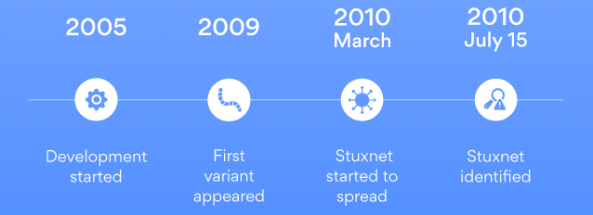
Perception about Stuxnet
Stuxnet has been in development from at least 2005 [7], even though it wasn’t identified or made public until 2010.
In March of 2010, the global spread of the worm began, however the first variant of the worm was detected in 2009.
Stuxnet spread in two waves.
Stuxnet did not inflict considerable damage outside of its original target, but it did serve as a paradigm for later viruses that attacked a variety of infrastructure types and national governments [8].
Notes:
Although development of Stuxnet began in 2005, it was not discovered until 2010. The first version of Stuxnet, dubbed 0.5 [McD13], was discovered in 2010. The centrifuges at the Natanz uranium enrichment facility began malfunctioning at an alarming pace in January 2010, according to inspectors. At that time, they were unable to determine what had caused the breakdown. When researchers checked one of the computers five months later, they discovered malware files [8].The initial strain of the worm arrived in 2009, but it didn't begin spreading until March of 2010. It wasn't until a distributed denial of service (DDoS) assault on a mailing list for industrial system security on July 15, 2010 that the worm's existence was publicly recognized. The assault cut off a vital data feed for utilities and manufacturing facilities.There seemed to be two waves of Stuxnet's propagation. The first assault was stealthier and more selective than the subsequent one. During the second wave, which was more pervasive and aggressive, the name "Stuxnet" acquired common knowledge. Over 20,000 equipment in 14 Iranian nuclear sites were infected, including roughly 900 centrifuges.The Stuxnet worm didn't do much harm beyond its intended target, but it did set a precedent for future malware that targets critical infrastructure and sovereign governments. Non-nuclear facilities are likewise a target of variants.

Slide 9
Perception of Iranian
Many analysts believe that the United States and Israel launched the Stuxnet cyberattack to destroy Iran's nuclear equipment and disrupt a program that they believe is meant to manufacture nuclear weapons [9].
According to Iranian officials, Bushehr staff computers were infiltrated with Stuxnet, although the malware did not cause significant harm [10].
Mohammad Ahmadian, the acting head of Iran's Atomic Energy Organization, indicated that accusations of significant damage to the Bushehr plant were a premeditated attempt by nations opposed to the country's nuclear program, but that they should be investigated nonetheless [11].
According to a senior Iranian official, Iran should investigate allegations that the Stuxnet computer worm has severely damaged the country's first nuclear power station.
Notes:
Many of the concerns being voiced in the media and among international public opinion about the Stuxnet virus are an attempt to cause alarm among the Iranian people and people of the area in order to stall the construction of the nuclear power plant "as he told the ISNA news service. "Therefore, it is essential that professionals in the industry do research to determine the accuracy of these claims.Many experts think the United States and Israel were behind the Stuxnet cyberattack, which was designed to disable Iran's nuclear equipment and slow down a program they suspect is intended to produce nuclear weapons.Authorities in Iran have admitted that the Stuxnet worm affected computers at the Bushehr nuclear facility, although they have claimed the attack had no effect on the plant's critical infrastructure. Their claim that they are making nuclear weapons is refuted.

Slide 10
References:
[1] Wikipedia Contributors (2019). Stuxnet. [online] Wikipedia. Available at: https://en.wikipedia.org/wiki/Stuxnet.
[2] CLEMSON, “Stuxnet,” www.clemson.edu. https://www.cs.clemson.edu (accessed Oct. 20, 2022).
[3] L. Franceschi-Bicchierai, “The History of Stuxnet: The World’s First True Cyberweapon,” www.vice.com, 2016. https://www.vice.com/en/article/ezp58m/the-history-of-stuxnet-the-worlds-first-true-cyberweapon-5886b74d80d84e45e7bd22ee.
[4] E. D. Knapp and J. T. Langill, “Stuxnet - an overview | ScienceDirect Topics,” www.sciencedirect.com, 2015. https://www.sciencedirect.com/topics/computer-science/stuxnet#:~:text=Stuxnet%20was%20discovered%20on%20systems (accessed Oct. 20, 2022).
[5] B. Flanagan, “Former CIA chief speaks out on Iran Stuxnet attack,” The National, 2011. https://www.thenationalnews.com/business/former-cia-chief-speaks-out-on-iran-stuxnet-attack-1.392917#:~:text=The%20Stuxnet%20virus%20cost%20an .
[6] “What Is Stuxnet? | Trellix,” www.trellix.com. https://www.trellix.com/en-us/security-awareness/ransomware/what-is-stuxnet.html
[7] J. Fruhlinger, “Stuxnet explained: The first known cyberweapon,” CSO Online, Aug. 31, 2022. https://www.csoonline.com/article/3218104/stuxnet-explained-the-first-known-cyberweapon.html#:~:text=Stuxnet%20was%20first%20identified%20 by (accessed Oct. 20, 2022).
[8] “Stuxnet explained — the worm that went nuclear | NordVPN,” nordvpn.com, Mar. 10, 2022. https://nordvpn.com/blog/stuxnet-virus/
[9] “US and Israel were behind Stuxnet claims researcher,” dhushara.com, 2011. https://www.dhushara.com/Biocrisis/11/apr/stuxnet.pdf
[10] “Iran says it has detected second cyber attack,” Reuters, Apr. 25, 2011. Accessed: Oct. 20, 2022. [Online]. Available: https://www.reuters.com/article/oukin-uk-iran-computer-virus-idUKTRE73O1P720110425
[11] C. Arthur, “Iran should investigate Stuxnet virus, says atomic chief,” the Guardian, Feb. 04, 2011. https://www.theguardian.com/world/2011/feb/04/iran-stuxnet-virus (accessed Oct. 20, 2022).

Slide 11
Thank You

